Slide 1
Health Equity and Aging in Missouri
Dr. Dwayne Proctor President and CEO, Missouri Foundation for Health
Photo: Wikimedia.org
Notes:
Welcome everyone, and thanks for that introduction, Michelle. I’m glad we could all come together today to learn from each other.

Slide 2
About the Foundation
Working in partnership with communities and nonprofits, Missouri Foundation for Health is transforming systems to eliminate inequities within all aspects of health and addressing the social and economic factors that shape health outcomes.
The Foundation is building a more equitable future through:
collaboration
convening
knowledge sharing
strategic investment
Notes:
As you can see, convening and knowledge sharing are two ways the Foundation works with community partners to make health equity a reality for all Missourians.

Slide 3
Our Vision
Missourians from all backgrounds will have a fair and just opportunity to live their healthiest lives.
Notes:
Our recently updated mission statement reflects that commitment.

Slide 4
Health Equity
Health equity means that everyone has a fair and just opportunity to be as healthy as possible. To achieve health equity, obstacles to health such as poverty, discrimination, and their consequences, including a lack of access to good jobs with fair pay, quality education and housing, safe environments, and health care must be removed.
Notes:
Here’s our working definition. We have an expansive approach in defining what impacts the physical, emotional, and mental health of Missourians. When health outcomes cannot be accurately predicted by racial or geographic indicators – especially indicators created and upheld by systemic and structural racism – then we’ll know we’re on the right track.

Slide 5
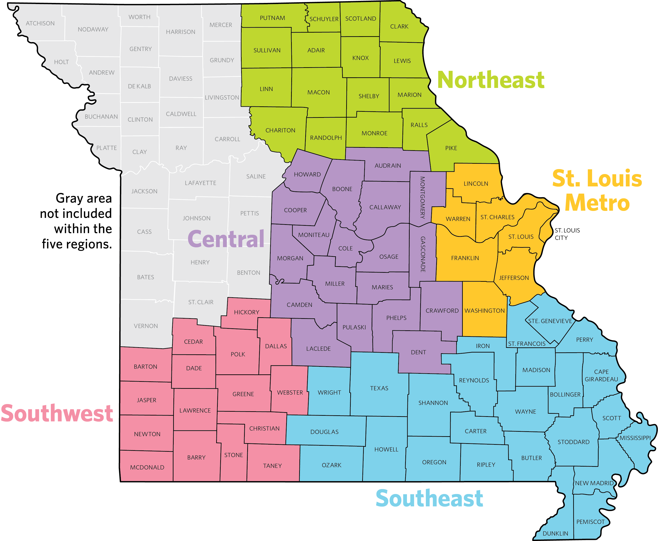
Health Equity
Notes:
Health equity is a phrase we hear a lot. As a former academic, I MUST make sure we’re on the same page for our discussions throughout the day.

Slide 6
Health Equity & Intersectional Equity
Notes:
Intersectional Equity,” a term coined by Kimberlé Crenshaw of the African American Policy Forum, asserts that Black, Indigenous, and people of color (BIPOC) are often disadvantaged by multiple and interconnected sources of oppression that compound historical patterns of exclusion.
We understand that these concepts and terms are not new for you. You're working with colleauges in this building every day to try and address health equity and move the needle in a systemic manner. For example,
Pre and Post-exposure Prohylaxis (PREP) access legislation that was passed last year to allow pharmacists to dispense pre- and post-exposure medication for HIV prevention without a prescription. We know HIV rates disproportionately affect Black/African American and Hispanic/Latino populations as well as the LGBTQ community.
Work to invest state funding into harm reduction strategies like medication assisted treatment, both in and out of prison, and change the narrative on syringe service programs/needle exchanges are huge wins, even if they're still in progress. This helps to ensure we can divert resources from incarceration to prevention and diversion, especially in areas that already disproportionately impact communities represented in this slide.

Slide 7
Systemic and Structural Racism
Notes:
Systemic and structural racism are forms of racism that are pervasively and deeply embedded in systems, laws, written or unwritten policies, and entrenched practices and beliefs that produce, condone, and perpetuate widespread unfair treatment and oppression of people of color, with adverse health consequences. Even when policies or laws are stricken from the books, the consequences reverberate in people’s lives. It’s on all of us to redress those harms.

Slide 8
Redlining
Between 1935 and 1940, the Home Owners' Loan Corporation (HOLC) graded thousands of American neighborhoods.
Assessed the relative security or riskiness of those areas for banks, savings and loans, and mortgage lenders.

Slide 9
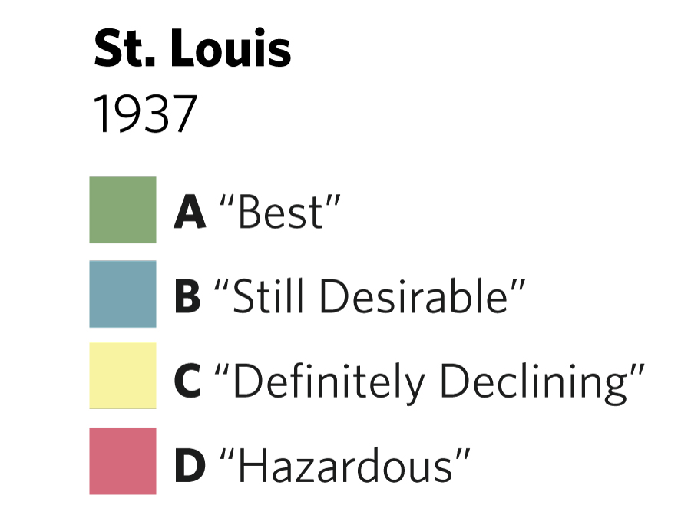
1937 Redlining Map – St. Louis
Notes:
Neighborhoods they deemed "best" and safe investments were given a grade of A and colored green. Those that were deemed "hazardous" were given a grade of "D" and colored red.
If residents were African Americans or, to a lesser extent, immigrants or Jews, HOLC deemed them a threat to the stability of home values and described their presence as an "infiltration.“
J.D. and Ethel Shelley bought a house in The Ville neighborhood and challenged its restrictive racial covenant, winning their case in the U.S. Supreme Court in 1948. The Fair Housing Act of 1968 made racial covenants not only unenforceable but illegal.
Multiple studies show that redlining’s harmful legacy has left nonwhite communities struggling with air pollution, reproductive health disorders, and a lower life expectancy more than 50 years later.

Slide 10
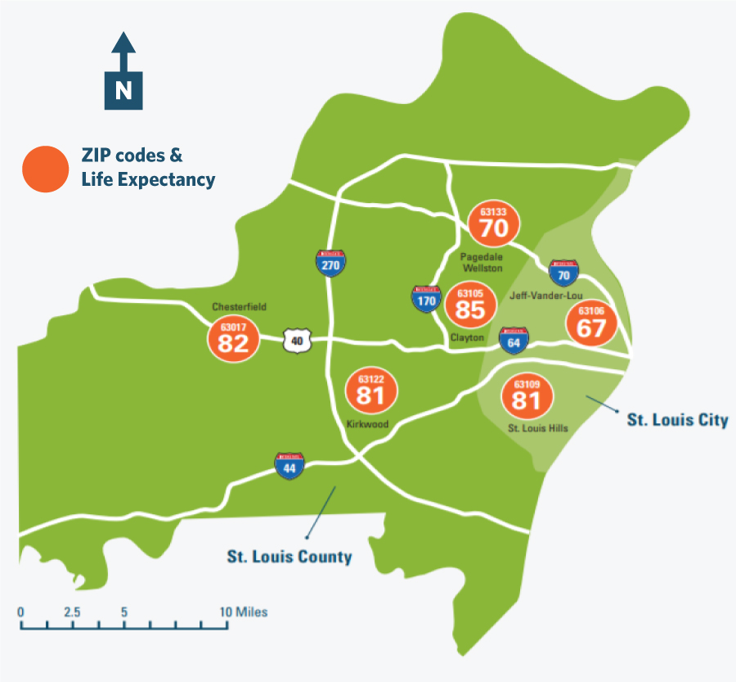
Life Expectancy: St. Louis
A child born in 63106 near the Jeff-Vander-Lou neighborhood can expect to live 18 fewer years than a child born in 63105 (Clayton)
Notes:
Let's look at housing and health.
Over the course of decades, a discriminatory lending practice known as redlining, prevented Black families and other people of color from obtaining mortgages in certain neighborhoods. This decades-old housing policy has had a lasting effect on American society. Today, those same neighborhoods have higher rates of poverty, poorer health outcomes, and lower life expectancy.
Source – For Sake of All Report, which MFH Supported- https://cpb-us-w2.wpmucdn.com/sites.wustl.edu/dist/3/1454/files/2018/06/FSOA_report_2-17zd1xm.pdf.

Slide 11
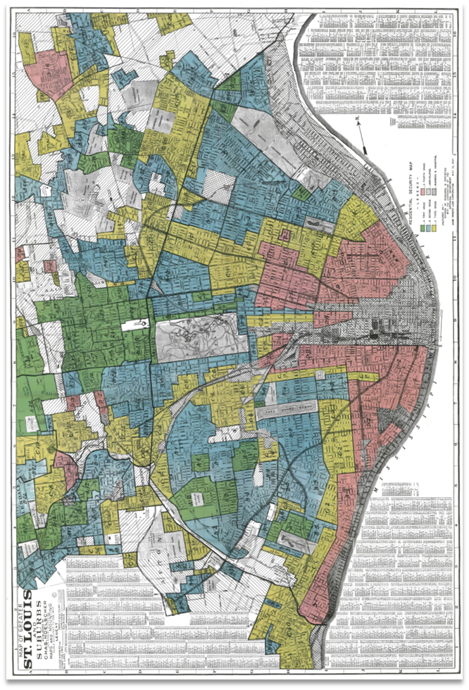
Redlining and Life Expectancy Maps
Notes:
People living in historically redlined communities have a significant reduction in their expected life span.

Slide 12
Redlining had Negative Impacts on...
Healthcare
Housing
Employment and income
Voting
Public safety
Transportation
Social and ecological environment

Slide 13
Social Determinants of Health
Healthcare
Housing
Employment and income
Voting
Public safety
Transportation
Social and ecological environment

Slide 14
Realtor Apology

Slide 15
Lack of Trust
Eventually, people lose faith in the systems that discriminate against them.

Slide 16
Thank You!
Notes:
Health equity is a phrase we hear a lot. As a former academic, I MUST make sure we’re on the same page for our discussions throughout the day.

